Slide 1
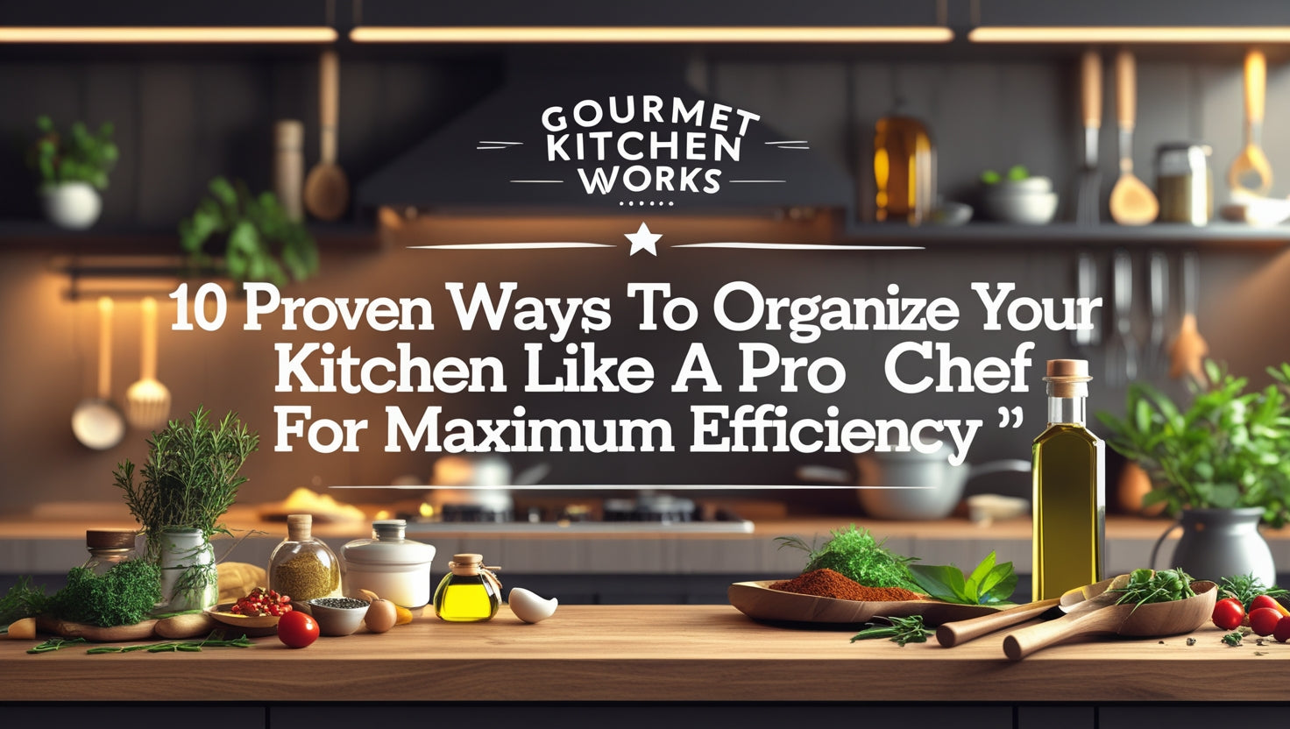

Gourmet kitchen works
AI
Overview

Slide 2
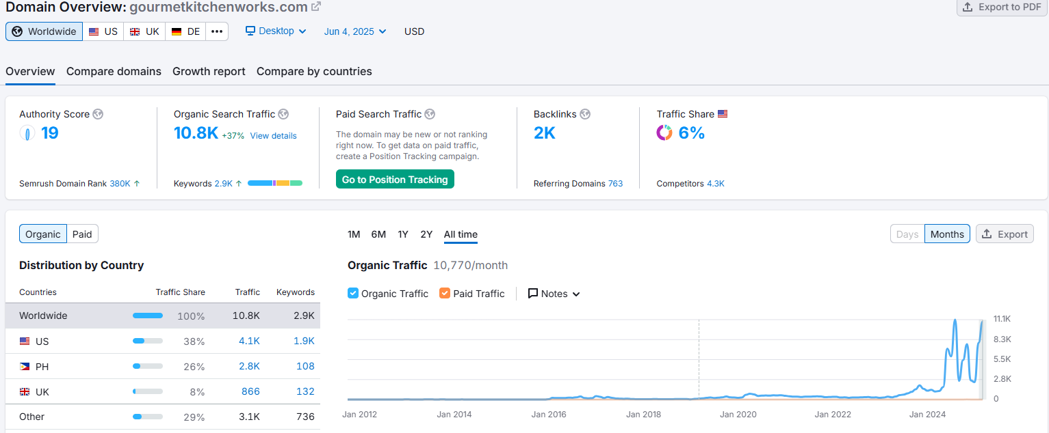
Domain Overview

Slide 3
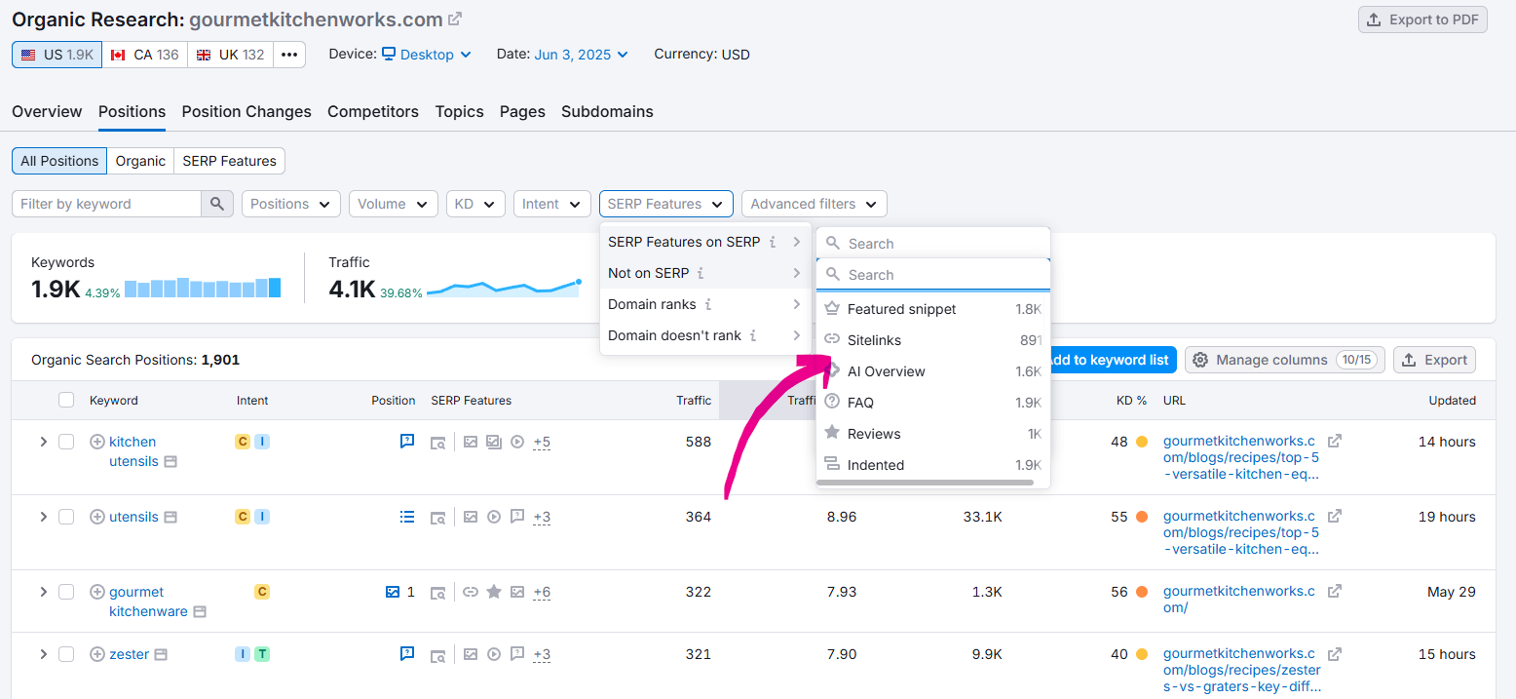
Keyword Overview

Slide 4
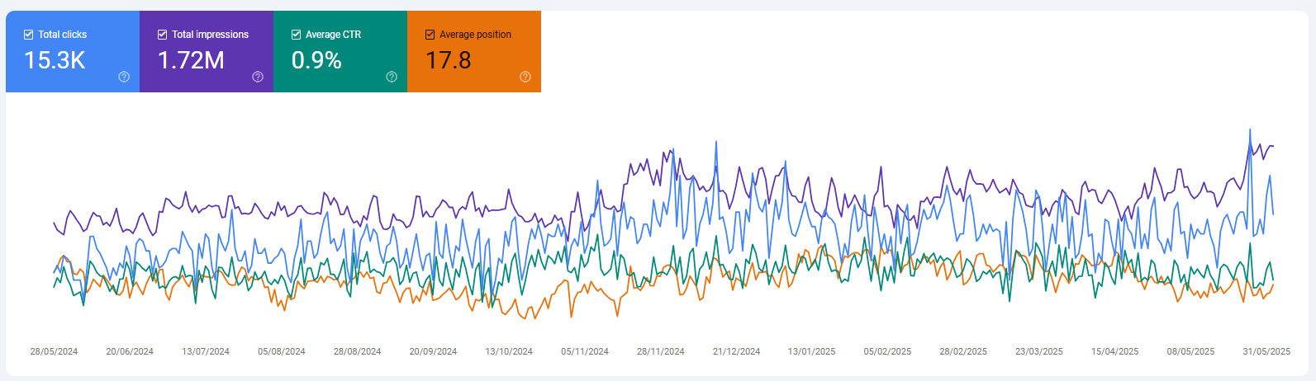
Search Console Data

Slide 5
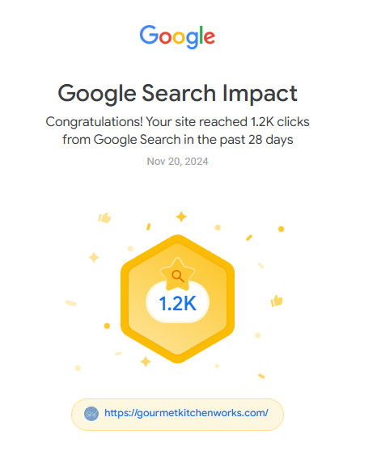
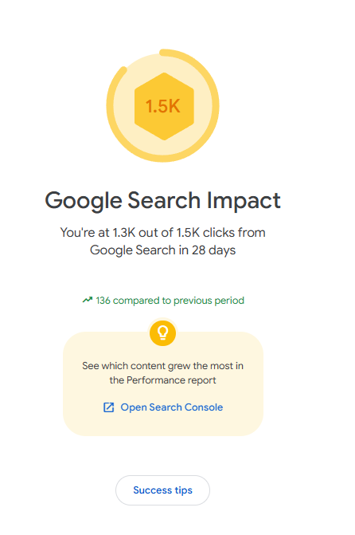
Search Console Data

Slide 6
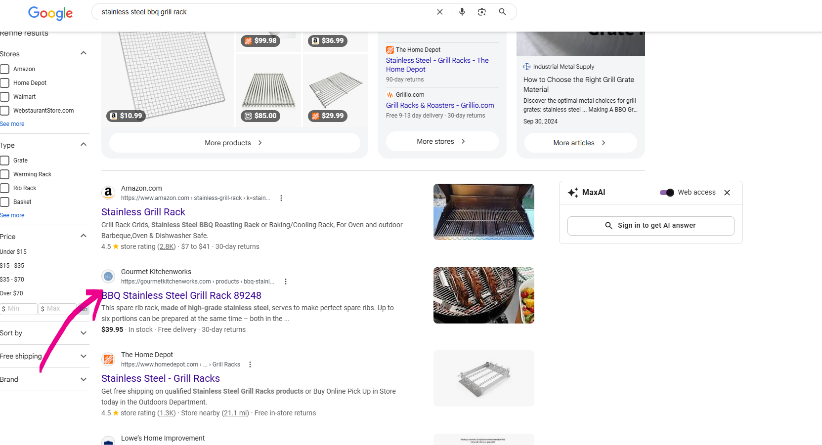
Blog/AI Results
This slide shows Some of the Blogs which are ranking on Top with AI Result Feature.

Slide 7
Thank You

